Slide 1
OpenShift Quota
By : Oren Oichman
Title: Senior Solution Architect
Email : ooichman@redhat.com
IRC : two_oes/ooichman

Slide 2
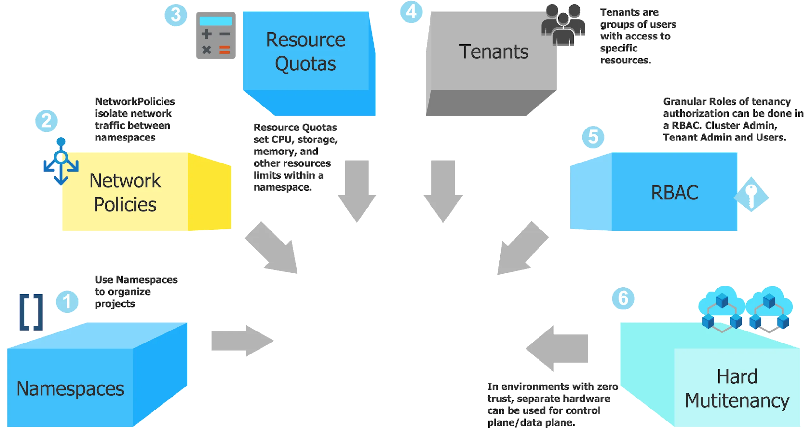

OpenShift Quota
Oren Oichman - custom K8S automations with Operators
Notes:
I want to change yourself on the philosophical level and ask yourself (how does the operator completes the cycle)

Slide 3
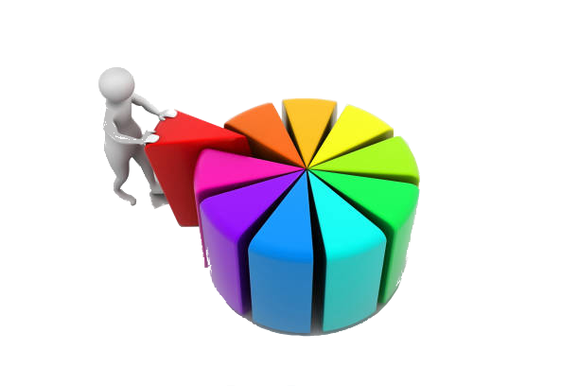
Definitions of quota
A resource quota, defined by a ResourceQuota object, provides constraints that limit aggregate resource consumption per project
OpenShift Quota
Oren Oichman - custom K8S automations with Operators
Notes:
I want to change yourself on the philosophical level and ask yourself (how does the operator completes the cycle)

Slide 4
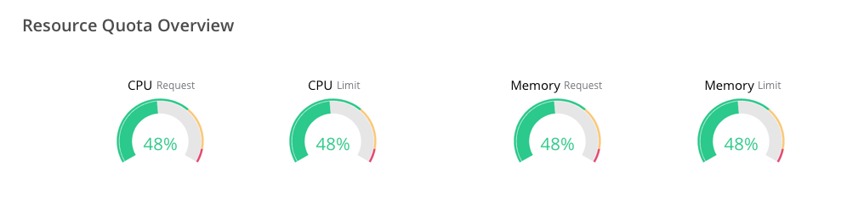
Quota In OpenShift
OpenShift Quota
Oren Oichman - custom K8S automations with Operators
Notes:
I want to change yourself on the philosophical level and ask yourself (how does the operator completes the cycle)

Slide 5

How does Quota Helps
OpenShift Quota
Oren Oichman - custom K8S automations with Operators
Notes:
I want to change yourself on the philosophical level and ask yourself (how does the operator completes the cycle)

Slide 6

2 Types of Quota
Resource quotas per project
Resource quotas across multiple projects
OpenShift Quota
Oren Oichman - custom K8S automations with Operators
Notes:
I want to change yourself on the philosophical level and ask yourself (how does the operator completes the cycle)

Slide 7
Resources managed by quotas
OpenShift Quota
CPU/request.cpu | The sum of CPU requests across all pods in a non-terminal state cannot exceed this value. cpu and requests.cpu are the same value and can be used interchangeably.
memory/request.memory | The sum of memory requests across all pods in a non-terminal state cannot exceed this value. memory and requests.memory are the same value and can be used interchangeably.
ephemeral storage/request.ephemeral storage | The sum of local ephemeral storage requests across all pods in a non-terminal state cannot exceed this value. ephemeral-storage and requests.ephemeral-storage are the same value and can be used interchangeably. This resource is available only if you enabled the ephemeral storage technology preview. This feature is disabled by default.
Oren Oichman - custom K8S automations with Operators
Notes:
I want to change yourself on the philosophical level and ask yourself (how does the operator completes the cycle)

Slide 8
Resources managed by quotas..continue
OpenShift Quota
limits.cpu | The sum of CPU limits across all pods in a non-terminal state cannot exceed this value.
limits.memory | The sum of memory limits across all pods in a non-terminal state cannot exceed this value.
limits.ephemeral storage | The sum of ephemeral storage limits across all pods in a non-terminal state cannot exceed this value. This resource is available only if you enabled the ephemeral storage technology preview. This feature is disabled by default.
Oren Oichman - custom K8S automations with Operators
Notes:
I want to change yourself on the philosophical level and ask yourself (how does the operator completes the cycle)

Slide 9
Storage resources managed by quota
Resource Name | Description
requests.storage | The sum of storage requests across all persistent volume claims in any state cannot exceed this value.
persistentvolumeclaims | The total number of persistent volume claims that can exist in the project.
<storage-class-name>.storageclass.storage.k8s.io/requests.storage | The sum of storage requests across all persistent volume claims in any state that have a matching storage class, cannot exceed this value.
<storage-class-name>.storageclass.storage.k8s.io/persistentvolumeclaims | The total number of persistent volume claims with a matching storage class that can exist in the project.

Slide 10
Object counts managed by quota
Resource Name | Description
pods | The total number of pods in a non-terminal state that can exist in the project.
replicationcontrollers | The total number of ReplicationControllers that can exist in the project.
resourcequotas | The total number of resource quotas that can exist in the project.
services | The total number of services that can exist in the project.
services.loadbalancers | The total number of services of type LoadBalancer that can exist in the project.
services.nodeports | The total number of services of type NodePort that can exist in the project.
secrets | The total number of secrets that can exist in the project.
configmaps | The total number of ConfigMap objects that can exist in the project.
persistentvolumeclaims | The total number of persistent volume claims that can exist in the project.
openshift.io/imagestreams | The total number of imagestreams that can exist in the project.

Slide 11
Sample Quota
apiVersion: v1 kind: ResourceQuota metadata: name: core-object-counts spec: hard: memory: "1Gi" cpu: "20" pods: "10" persistentvolumeclaims: "4" replicationcontrollers: "20" secrets: "10" services: "10"

Slide 12
View Quotas
$ oc get quota
NAME AGE
core-object-counts 29m
memory-quotas 29m

Slide 13
Restrict resource consumption with limit ranges
A limit range, defined by a LimitRange object, restricts resource consumption in a project. In the project you can set specific resource limits for a pod, container, image, image stream, or persistent volume claim (PVC).

Slide 14
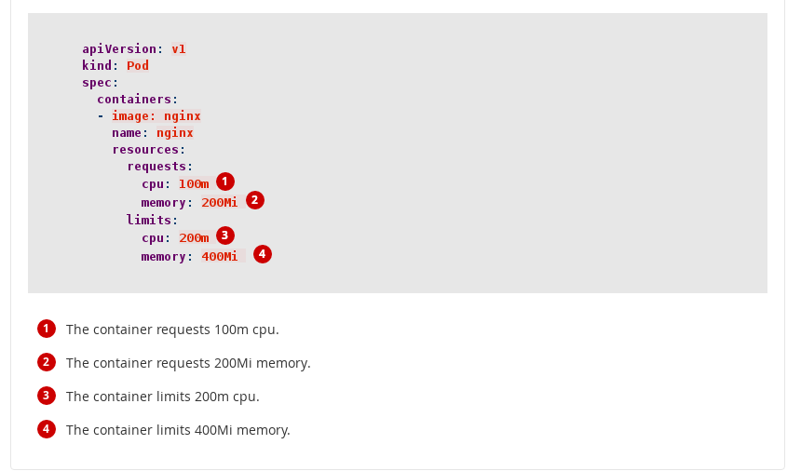
Requests and Limits

Slide 15
Quota summary
Setting Quotas: https://docs.openshift.com/container-platform/4.6/applications/quotas/quotas-setting-per-project.html
Setting Multi-Project Quotas: https://docs.openshift.com/container-platform/4.6/applications/quotas/quotas-setting-across-multiple-projects.html
Setting Limit Ranges: https://docs.openshift.com/container-platform/4.6/nodes/clusters/nodes-cluster-limit-ranges.html

Slide 16



The History of Containers
Begin Exercise 4
Source:
Insert source data here
Insert source data here
Insert source data here

